Slide 1

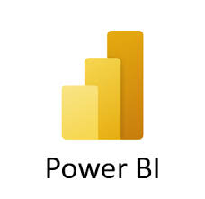
DRILL Mode In the Power BI
By- PRAGATI SHINDE

Slide 2


DRILL Mode
To use the drill mode, the Power BI visual must have a hierarchy.
Then, you can select one of the visual elements, like a bar, line, or bubble, to display the individual.

Slide 3

Drill Down(Click the data point to drill down) Drill Up Go to the next level in the hierarchy Expand all down one level down in the hierarchy

Slide 4
Difference in Drill Down and Drill Up: Drill Down – Drill down in Power BI allows users to move from a higher level of data to a more detailed level. Drill Up- Drill up feature allows users to move from a lower level of data to a higher level of data.

Slide 5

DRILL DOWN
Power BI Drill down is a feature that allows users to view data at a more granular level.
It is providing more detailed insights and enabling them to identify patterns and trends that may not be visible at higher levels of data granularity.

Slide 6

DRILL DOWN
Drill-Down plays a vital role in breaking down data and providing a comprehensible data for easy understanding.

Slide 7

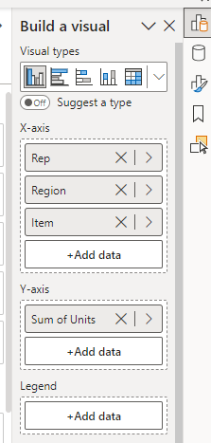
Create a single visual with the detailed information of each seller, what is the unit sold for each region with the product items.
Select a Clustered Column Chart from visual gallery.
Select Rep, Region, Item on X-axis in similar order.
Select sum of units on Y-axis.

Slide 8

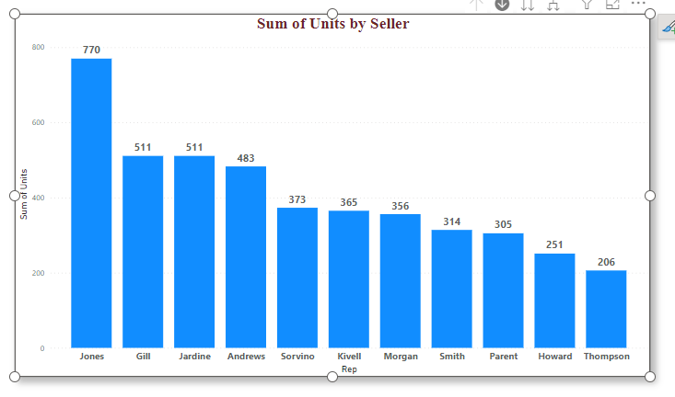
Turn on the drill-down option by selecting the single downward arrow.
The grey background indicates that the drill-down option is turned on.

Slide 9
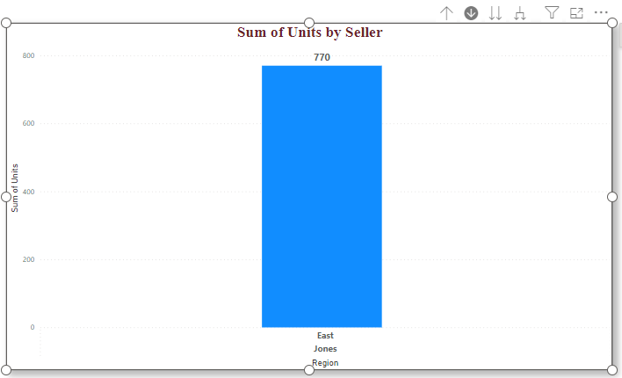
Continue to drill down one field at a time by selecting Jones. The bar chart now shows the segments for the Jones Seller in the East region.

Slide 10
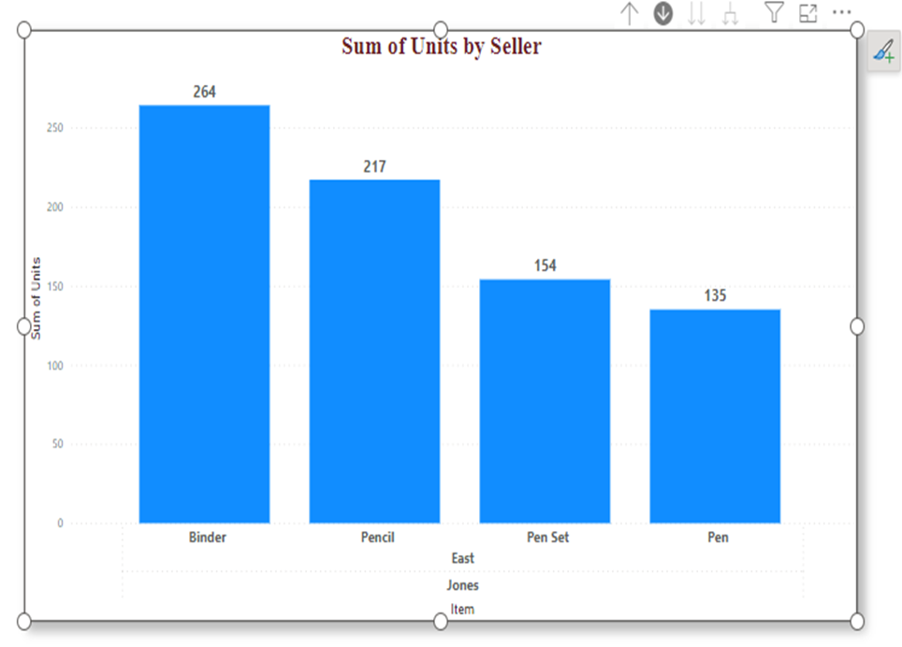
Drill down to the regions by selecting the East bar. Now you are at the items level.
Jones seller, 770 sum of units in East region with the product items.

Slide 11
Thank You.

